Slide 1
Observational Studies II
Nora Kalagi, MSc., PhD
Yasser Albogami, MPH., PhD
PHCL 435
September 2023

Slide 2
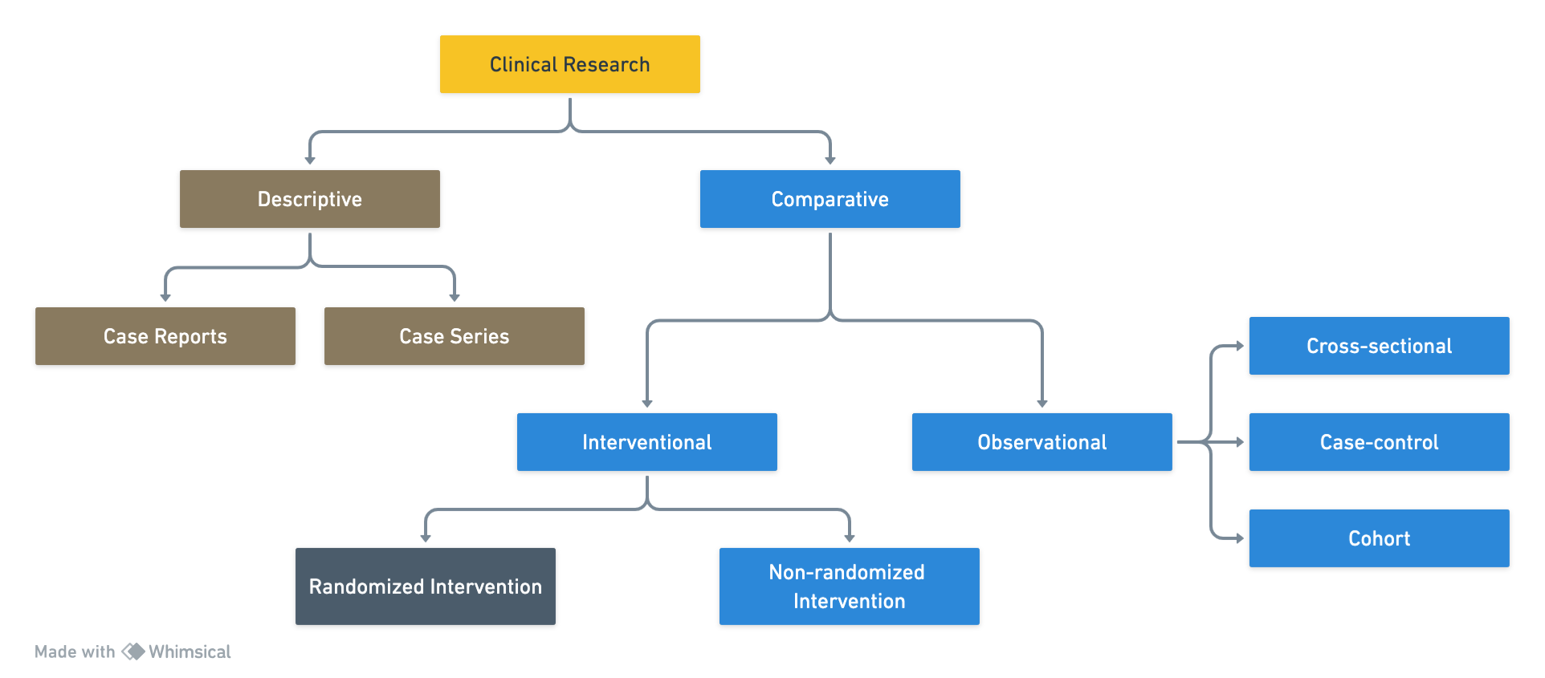

Clinical Research Types

Slide 3

Comparative Clinical Research Observational Studies
Cohort Studies

Slide 4
Today’s Topics
What is Cohort study?
Measures of association in cohorts
Types of Cohorts
Open vs. closed
Retrospective and prospective
General vs. exposure/special
Time in a cohort study
Cohort-specific biases

Slide 5
Cohort Study Definitions

Slide 6
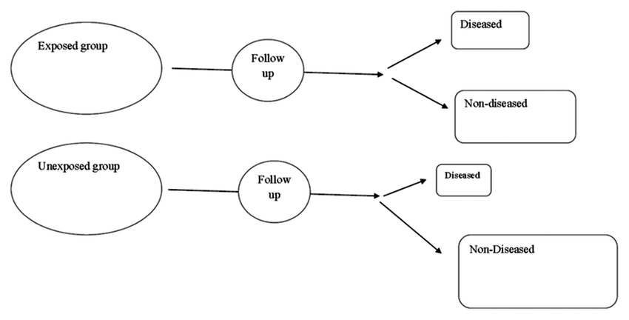
What is Cohort Study?
First step in cohort studies is to select participants based on exposure status
Compare disease pattern in exposed or unexposed
Follow all cohort participants over time to measure disease frequency

Slide 7
Essential Cohort Criteria and Exclusion
All members must be “at risk for the outcome”
Cohort members are free of disease but “at risk”
Exclude those not at risk, for instance:
In a study of uterine cancer
Men
Women with a history of hysterectomy
Women with prevalent uterine cancer

Slide 8

Selection into Study on Basis of Exposure Status
EXPOSURE
OUTCOME
?
?
Basis on which groups are selected at beginning of study
PRESENT ABSENT

Slide 9
Measures of Association in Cohorts

Slide 10
How to measure disease frequency in a cohort study?
Prevalence
Incidence Rate
Cumulative Incidence (or “Risk”)
Odds

Slide 11
2x2 Tables for Calculating Risk
 | Disease Status
Exposure Status | Positive | Negative
Exposed | a | b
Unexposed | c | d
Total exposed = a + b
Total unexposed = c + d
Total with disease = a + c
Total without disease = b + d

Slide 12
Cumulative Incidence Formula
Cumulative Incidence or Risk =
Number of incident cases
Total number at risk at the start of follow-up
Cumulative Incidence in the Exposed =
Number of incident cases among the exposed
Total number of exposed people at risk at the start of follow-up
Cumulative Incidence in the Unexposed =
Number of incident cases among the unexposed
Total number of unexposed people at risk at the start of follow-up

Slide 13
Risk Ratio or Cumulative Incidence Ratio
Risk of disease among those who were exposed
Cumulative incidence=a/(a + b)
Risk of disease among those who were not exposed
Cumulative incidence=c/(c + d)
Risk ratio = [a/(a + b)] / [c/(c + d)]
 | D+ | D-
E+ | a | b
E- | c | d

Slide 14
Risk Ratio Interpretation
Risk ratio compares the risk of disease in the exposed to the risk of disease in the unexposed
Risk ratio = 1.0
No association between exposure and risk of disease
Null value
Risk ratio <1
Exposure is protective, decreases risk of disease
Risk ratio >1
Exposure is harmful, increases risk of disease

Slide 15
Incidence Rate (IR) Formula
Incidence Rate =
Number of incident cases
Total at-risk person-time
Incidence Rate in the Exposed =
Number of incident cases among the exposed
Total at-risk exposed person-time
Incidence Rate in the Unexposed =
Number of incident cases among the unexposed
Total at-risk unexposed person-time

Slide 16
Incidence Rate Ratio
Rate of disease among those who were exposed
Incidence rate = a/N1
Rate of disease among those who were not exposed
Incidence rate = c/N0
Rate ratio = [a/N1] / [c/N0]
 | D+ | D- | P-Time
E+ | a | b | N₁
E- | c | d | N₀

Slide 17
Rate Ratio Interpretation
Rate ratio compares the rate of disease in the exposed to the rate of disease in the unexposed
Rate ratio = 1.0
No association between exposure and rate of disease
Null value
Rate ratio <1
Exposure is protective, decreases rate of disease
Rate ratio >1
Exposure is harmful, increases rate of disease

Slide 18
Types of Cohort Studies

Slide 19
Types of Cohort Studies
Closed vs. Open (Dynamic)
Determine appropriate measure of disease incidence
Retrospective vs. Prospective
Can impact bias in measurement and follow-up
Special (Exposure) vs. General
Can affect study power depending on rarity of exposure

Slide 20
Types of Cohort Studies Closed vs. Open Cohort

Slide 21
Closed Cohort
Defined by an irrevocable event (define start point and end point)
Fall 2020 epi class
Birth in the year 2000
Exposure doesn’t change over time
No losses to follow-up
Incidence measure:
Cumulative Incidence or Incidence Rate depending on the circumstances

Slide 22
Closed Cohort Studies
D+
D-
a | b
c | d
E+
Risk ratio = (a / a+b) / (c / c+d)
E-

Slide 23
Closed Cohort Studies- Time Varying Follow-Up
?
?
?
D+
D-
a | b
c | d
E+
Risk ratio = (a / a+b) / (c / c+d)
E-
LTFU invalidates person-
based analysis

Slide 24
Closed Cohort Studies: Time Varying Exposures
Time varying exposures invalidate risk ratio analysis
D+
Incidence Rate_{exposed} = (a / PT₁)
E+
a PT₁
Incidence Rate_{unexposed} = (c / PT₀)
Incidence Rate Ratio = (a / PT₁) / (c / PT₀)
E-
c PT₀

Slide 25
Fixed Cohort
Closed Cohort + the potential to have loss to follow-up
Appropriate outcome measure:
Incidence Rate

Slide 26
Open Cohort
Dynamic
Membership defined by a changeable characteristic
Example: Location (e.g., living in Riyadh)
Example: Marital status
New subjects added/eliminated during follow-up period
Exposure status may change over time
Appropriate outcome measure:
Incidence Rate

Slide 27
Open Cohort Studies
D+
E+
a PT₁
Incidence Rate Ratio = (a / PT₁) / (c / PT₀)
E-
c PT₀

Slide 28
Types of Cohort Studies Retrospective vs. Prospective Cohort

Slide 29
Retrospective vs. Prospective Cohorts
Depends on the timing of the cohort study
Follow-up period
Time period in which subject are followed to ascertain outcome of interest
At-risk period
Study period
Time period in which the investigator performs the study
Notes:
Two notions of time in Cohort studies

Slide 30
Retrospective vs. Prospective Cohorts
Prospective
Exposures are measured by the investigator before the outcome events occur
Follow up period occurs after investigator begin the study
Record incidence of outcome during follow-up period
Retrospective
Exposures are measured by the investigator after the outcome events occur
Follow up period occurs chronologically before the start of the study period
Record incidence of outcome during follow-up period

Slide 31
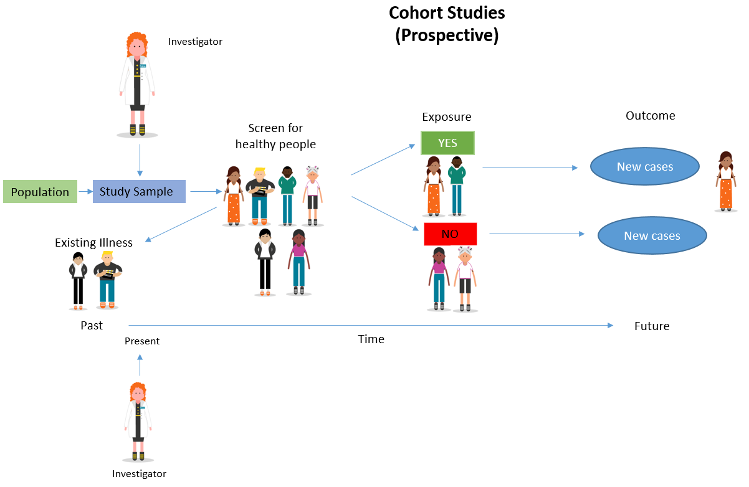
Time Perspective: Prospective
Begin with characterization of exposure groups and follow the subjects forward for occurrence of outcome
I am staring today BUT outcome has not yet occurred at initiation of study
Follow-up period

Slide 32
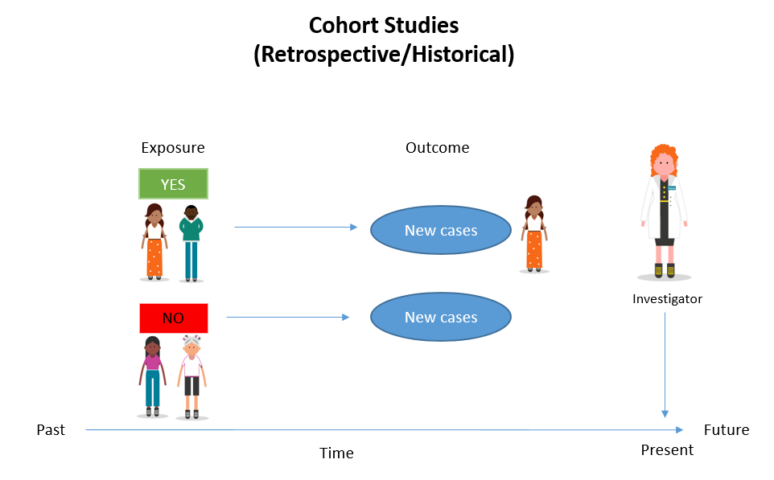
Time Perspective: Retrospective
Historical Cohort study
Begin with characterization of exposure groups and follow the subjects forward for the occurrence of the outcome
I am staring today BUT study begins AFTER the chronologic window of time for assessing outcome has already occurred
Usually, assessment of exposure through pre-existing records (registries, insurance companies,..etc)
Follow-up period

Slide 33
Retrospective Cohorts- Example
Title:
Thromboembolic Events During Continuous Vasopressin Infusions: A Retrospective Evaluation
Objectives:
To compare the incidence of venous thromboembolism (VTE) in patients with a diagnosis of shock who received vasopressin with those who did not receive vasopressin for hemodynamic support
Ann Pharmacother September 2007 41: 1383-1389
Notes:
The retrospective cohort study is a way to maintain methodological strength while gaining some efficiencies
associated with using existing data. Doepker et al.58 used a retrospective cohort approach to examine the
relationship between incidence of venous thromboembolism (VTE) and the use of vasopressin in patients with
shock. The authors examined the medical record to identify all patients aged 18 and older who were admitted to
the surgical or medical intensive care unit from September 2001 to June 2004 with a diagnosis code for shock.
To ensure that the selected subjects were free of the outcome at the beginning of the study, the authors excluded
any patients admitted to the critical care units with active treatment for VTE. The authors also excluded subjects
with a past history of VTE prior to vasopressin therapy, as well as those receiving vasopressin for any reason
other than the treatment of shock (e.g., variceal hemorrhage). Using the above criteria, the authors selected a
random sample of 350 subjects for the study. With this designated study cohort, subjects were separated into two
groups based on exposure status: vasopressin plus catecholamine therapy (e.g., epinephrine and dopamine) or
catecholamine therapy alone. Each subject could have a different index (start) date based on admission to the
critical care unit since this was an open cohort. Subjects' medical records were examined for the occurrence of
VTE after initiation of vasopressin or catecholamine therapy. To reduce the potential for bias in identifying the
outcome, the authors required positive evidence of a VTE from either a Doppler ultrasound or a spiral computer
tomography scan or a documented diagnosis for VTE on the official hospital discharge summary. The incidence
of VTE in the vasopressin group was 7.4% compared with 8% in the catecholamine therapy group. This was not
significantly different and remained so after adjusting for potential confounders

Slide 34
Retrospective Cohorts- Example
Method:
A retrospective, single-center, cohort study was conducted at an academic, tertiary care center with 350 patients with a diagnosis of shock. Patients from the intensive care unit were randomly selected and separated into 2 groups for comparison of those receiving only catecholamines with those receiving vasopressin with or without catecholamines for hypotension. Patients with diabetes insipidus or variceal hemorrhage and those with any documented history of VTE were excluded. The primary outcome, VTE occurrence, was defined as a positive Doppler ultrasound, spiral computed tomography, or documented diagnosis in the discharge records. Frequency and type of risk factors for VTE were compared between the 2 study arms
Notes:
The retrospective cohort study is a way to maintain methodological strength while gaining some efficiencies
associated with using existing data. Doepker et al.58 used a retrospective cohort approach to examine the
relationship between incidence of venous thromboembolism (VTE) and the use of vasopressin in patients with
shock. The authors examined the medical record to identify all patients aged 18 and older who were admitted to
the surgical or medical intensive care unit from September 2001 to June 2004 with a diagnosis code for shock.
To ensure that the selected subjects were free of the outcome at the beginning of the study, the authors excluded
any patients admitted to the critical care units with active treatment for VTE. The authors also excluded subjects
with a past history of VTE prior to vasopressin therapy, as well as those receiving vasopressin for any reason
other than the treatment of shock (e.g., variceal hemorrhage). Using the above criteria, the authors selected a
random sample of 350 subjects for the study. With this designated study cohort, subjects were separated into two
groups based on exposure status: vasopressin plus catecholamine therapy (e.g., epinephrine and dopamine) or
catecholamine therapy alone. Each subject could have a different index (start) date based on admission to the
critical care unit since this was an open cohort. Subjects' medical records were examined for the occurrence of
VTE after initiation of vasopressin or catecholamine therapy. To reduce the potential for bias in identifying the
outcome, the authors required positive evidence of a VTE from either a Doppler ultrasound or a spiral computer
tomography scan or a documented diagnosis for VTE on the official hospital discharge summary. The incidence
of VTE in the vasopressin group was 7.4% compared with 8% in the catecholamine therapy group. This was not
significantly different and remained so after adjusting for potential confounders

Slide 35
Merits of Prospective vs. Retrospective Cohort Studies
Prospective Cohort Study
More control of study exposure
More control of study the quality and quantity of the data
Less potential for bias
Retrospective Cohort Study
Less time consuming
Less expensive
Potential good starting point for scientific inquiry
Allow for studying of exposures that no longer occur
Notes:
Poor quality-limited to what is selected

Slide 36
Types of Cohort Studies Special (Exposure) vs. General Population Cohort

Slide 37
Opportunities to Assemble Cohorts
Assembling a general population cohort
Provide internal exposure and non-exposure groups
Appropriate when prevalence of exposure is not too small or too high:
General principle: optimal power when exposure is 50% and un-exposure is 50%
Example: Nurse’s Health Study
127,000 nurses between the ages of 30 and 55
Participants receive detailed questionnaires every 2 years in which they report medical histories, daily diet habits and major life events that have occurred in the past 24 months

Slide 38
Opportunities to Assemble Cohorts
2. Assembling special (exposure) cohort
A cohort enriched with a particular exposure
Chosen when exposure is rare in general population
Some follow from unfortunate circumstances with unexpected exposures
Diethylstilbestrol (DES) exposure cohort
Notes:
Diethylstilbestrol (DES), was prescribed to millions of pregnant women from 1938 to 1971 to help prevent pregnancy complications. In the late 1960s, doctors realized that there was a strong association between in utero exposure to DES and the incidence of rare vaginal and cervical cancer in young women and girls.

Slide 39
Time in a Cohort Study

Slide 40
Inclusion Criteria into a Cohort (how time matters)
Goal is to collect 2+ exposure groups to be as identical as possible with the exception of variance along a key characteristic of interest, the exposure
Cohort Inclusion criteria
Should be defined in terms of time and place
Want eligibility criteria to promote this exchangeability of unexposed that are as close to the expose as possible for all other parameters away from the exposure
Keep in mind that exposure contrast should be maximized for optimal power

Slide 41
Induction and Latent Periods
Induction Period: time between exposure and development of disease
Example: exposure to radiation may have a 3-5 year induction period for the risk of leukemia
Latent Period: time period between disease development and detection

Slide 42
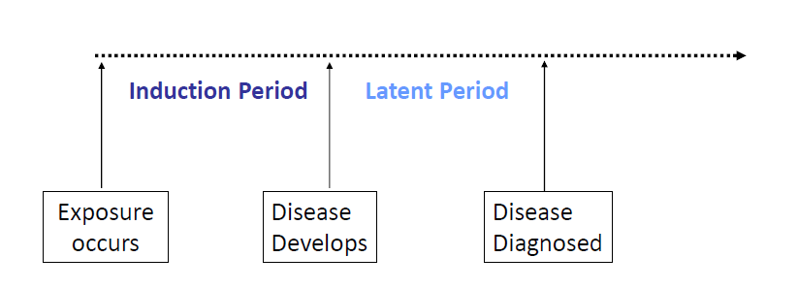
Induction and Latent Periods

Slide 43
Implications of these Periods
Outcomes that occur during Induction Period should not be attributable to the exposure
Exposed subjects are not at risk to develop the outcome by the exposure during this period
Outcomes and follow-up time observed during the induction period should not be assigned to the exposed group
Options
Eliminate such outcomes and follow-up time from the analysis
Assign to non-exposed group

Slide 44
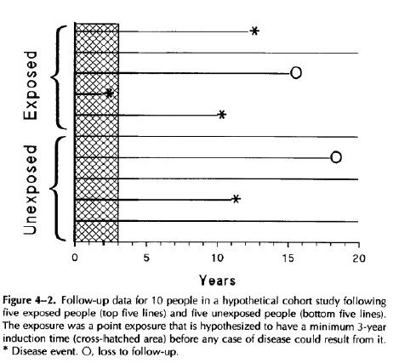
Implications of these Periods
Induction period that was not included in the study
Notes:
Eliminate some period of the follow -up

Slide 45
Cohort Design: Strengths
Avoid biases associated with retrospective studies (selection bias, recall bias), if done prospectively
Can directly measure disease incidence (vs. odds)
Ideal for rare exposures
Clear temporal relation between exposure and health outcome
Can measure multiple endpoints

Slide 46
Cohort Design: Challenges
Often expensive and require many years to complete
Inefficient for rare outcomes
Biases:
Differential loss-to-follow-up
Detection bias
Competing Risks

Slide 47

Other Types of Observational Study Designs

Slide 48
Other Observational Studies
Case-Cross over design
Nested case-control

Slide 49
Case-Cross Over Design
Same person taken as its own control (matched design)
Compare exposure in a “risk period” to a prior “control period” of the same duration
No control group needed

Slide 50
Case-Cross Over Design- When is it Suitable?
Acute diseases and exposures that change overtime
Transient exposures (drug adverse events…)
Key issue: the definition of the risk period

Slide 51
Nested Case-Control Studies
A case-control study nested within a cohort study
Subjects who develop the outcome during the study (cases) and on a sample of those who do not (controls)
Because the number of cases is probably fairly small, can match multiple controls to a given case to increase the power

Slide 52
Sample of Exam Questions

Slide 53
For each description below, identify the study design us
The Department of Health is suspicious that a community water fountain is the source of a recent cluster of Shigella sonnei infections. They question 10 people with confirmed infection about their proximity to the fountain during the two weeks prior to the onset of illness. They do the same for 20 people who are confirmed not to have been infected
Answer?

Slide 54
Calculate Incidence Rate Ratio
In a cohort study of heavy smoking and coronary heart disease, 30 women who were heavy smokers developed coronary heart disease during 63,359 person-years of follow-up, and 81 women who were non-smokers developed coronary heart disease during 302,375 person-years of follow-up.
Answer?
Interpretation?

Slide 55

THANK YOU
Any Questions?
nakalagi@ksu.edu.sa
yalbogami@ksu.edu.sa

